Slide 1
OCH Hackathon Project A
Project Presentation by Group: D³
Apr. 14th, 2017
Presented By: Cheryl Meng
Oracle Confidential – Internal/Restricted/Highly Restricted

Slide 2
OCH Hackathon Project A
Contents
Team Introduction
Requirements
Developing Approaches
Functionality Demo
Summary
Oracle Confidential – Internal/Restricted/Highly Restricted

Slide 3
Team Introduction
  We Are D³ !
  Requirement Analysis: All members
  DB Design & Back-end Business Logic Developer: Qingyi Meng
  Front-end Developer: Xujiong Dong & Qi Qian
  Controller Developer: Xiaoyuan Dai
  Deployment: Zan Gao
Oracle Confidential – Internal/Restricted/Highly Restricted

Slide 4
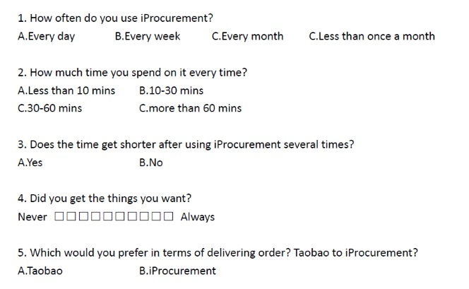
Survey time
Oracle Confidential – Internal/Restricted/Highly Restricted

Slide 5
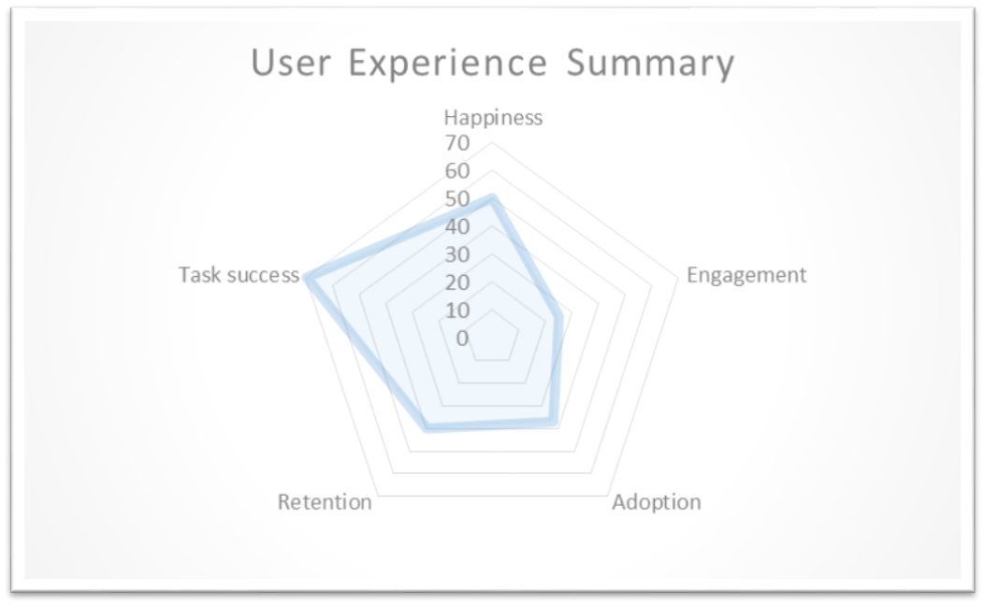
Survey time
Oracle Confidential – Internal/Restricted/Highly Restricted

Slide 6
Special Case Study
  Stella Zhang
  Department: Facilities
  Frequency of Usage: Almost Every Working Days
Oracle Confidential – Internal/Restricted/Highly Restricted

Slide 7

Special Case Study
  Stella Zhang
  Department: Facilities
  Frequency of Usage: Almost Every Working Days
  Feedback: Still Hard to Use
Oracle Confidential – Internal/Restricted/Highly Restricted

Slide 8
Requirements
  Struggling to get on with our procurement?
  Lost & Found?
  Online Love Affair with Things You are Buying?
  Carrying Laptop Everywhere?
Oracle Confidential – Internal/Restricted/Highly Restricted

Slide 9
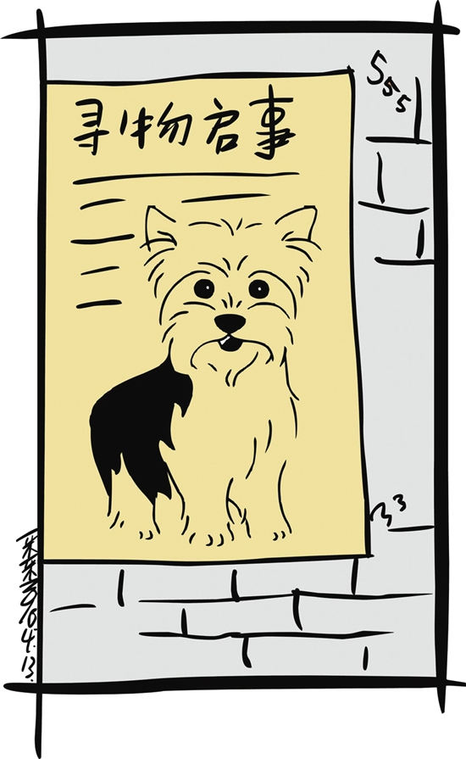
Lost & Found?
Oracle Confidential – Internal/Restricted/Highly Restricted

Slide 10
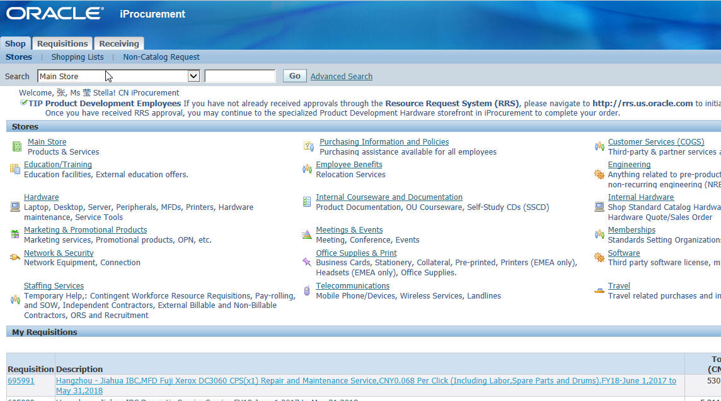
Lost & Found?
Oracle Confidential – Internal/Restricted/Highly Restricted

Slide 11

Online Love Affair?
Oracle Confidential – Internal/Restricted/Highly Restricted

Slide 12
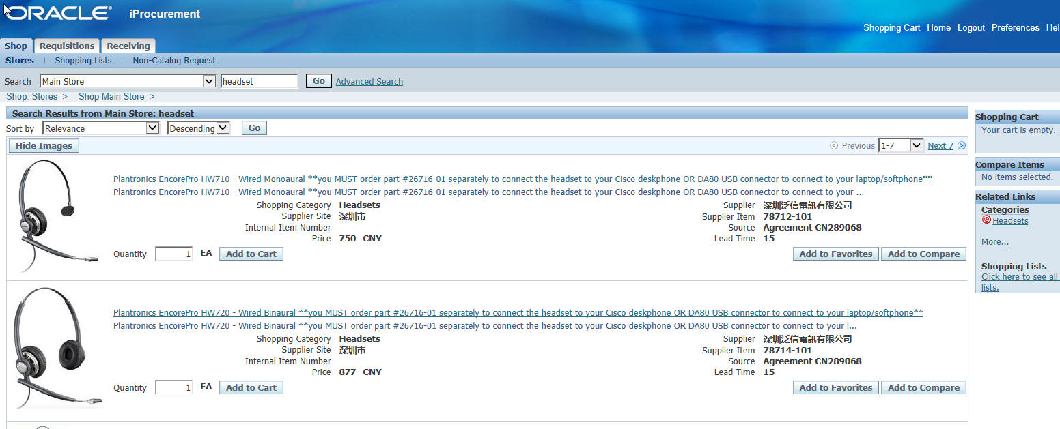
Online Love Affair?
Oracle Confidential – Internal/Restricted/Highly Restricted

Slide 13

Carrying Laptop Everywhere?
Oracle Confidential – Internal/Restricted/Highly Restricted

Slide 14

Carrying Laptop Everywhere?
Oracle Confidential – Internal/Restricted/Highly Restricted

Slide 15
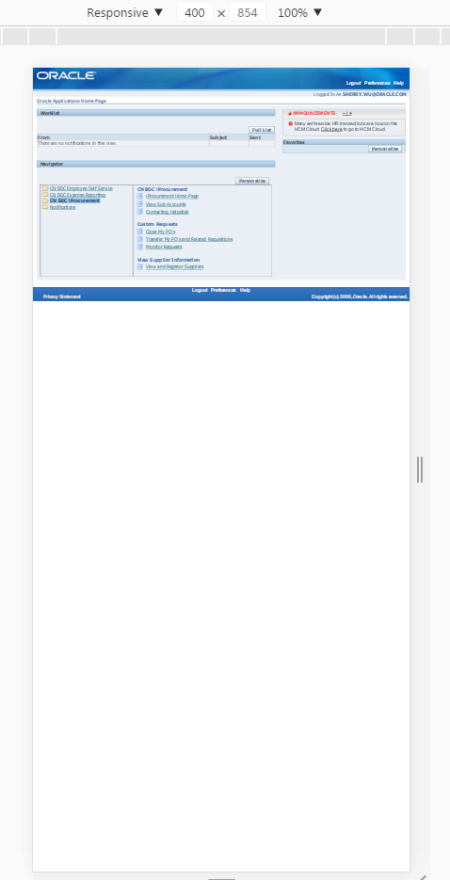
Carrying Laptop Everywhere?
Oracle Confidential – Internal/Restricted/Highly Restricted

Slide 16
Requirements
  Struggling to get on with our procurement?
  Lost & Found?
  Online Love Affair with Things You are Buying?
  Carrying Laptop Everywhere?
Should we Suffer?
Oracle Confidential – Internal/Restricted/Highly Restricted

Slide 17

Requirements
  Struggling to get on with our procurement?
  Lost & Found?
  Online Love Affair with Things You are Buying?
  Carrying Laptop Everywhere?
Should we Suffer?
Oracle Confidential – Internal/Restricted/Highly Restricted

Slide 18
Requirements
  What User Really Want?
  More Flexible Searching Criteria
  More Aspects of the Items to be Displayed
  Adaptive in Mobile Device
Oracle Confidential – Internal/Restricted/Highly Restricted

Slide 19
Requirements
  What User Really Want?
  More Flexible Searching Criteria
  More Aspects of the Items to be Displayed
  Adaptive in Mobile Device
Say No to Compromise
Oracle Confidential – Internal/Restricted/Highly Restricted

Slide 20
Developing Approaches
  Server: Weblogic 12.2.1
  DB: Oracle 12c (12.2.1) / 11g (11.2.0),
  JDBC: Pure SQL
  Controller: ADF
  Web page: JET
Oracle Confidential – Internal/Restricted/Highly Restricted

Slide 21
Functionality Demo
Oracle Confidential – Internal/Restricted/Highly Restricted

Slide 22
Summary
  What the Difference We’ve made?
  Users First: Ease the Burden for Users
  Head for Future: Ensure Great Extensibility
Oracle Confidential – Internal/Restricted/Highly Restricted

Slide 23
Thanks
Great Many Thanks to You All Here!
Special thanks to:
  Sponsors & HRs & All the supporting groups
  Stella Zhang (SH Facility Department)
  Colleagues from Shanghai for the Data Samples
Oracle Confidential – Internal/Restricted/Highly Restricted

Slide 24
Q & A
Oracle Confidential – Internal/Restricted/Highly Restricted

